Slide 1
RAJESHWARI VEDACHALAM GOVERNMENT ARTS COLLEGE,CHENGALPATTU-603 001. department of computer science Optimizing Spam Filtering with Machine Learning
GUIDE NAME : Dr.T.VANI
TEAM MEMBERS’ NAME: Muniyammal K
Durgadevi D
Jesiviolet V
Nisha k

Slide 2

Introduction:
Spam SMS may include advertisements of drugs, software, adult content, health insurance(or) other fraudulent advertisements.
Problem: Unsolicited commercial
SMS commonly known as spam is a
pressing problem on the internet.
Goal: To avoid SPAM SMS.

Slide 3
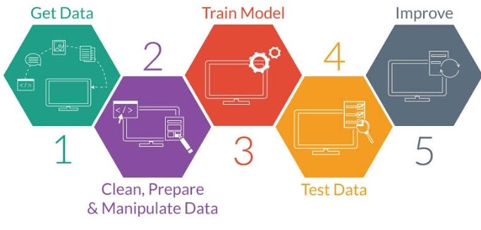
Overview Diagram:
I reviewed in details one way of SMS Spam filter implementaion using Machine Learning Techniques:
Collect the dataset
Preparing the collected data
Exploratory Data Analysis
Performance Testing
Tuning
Save the Model

Slide 4
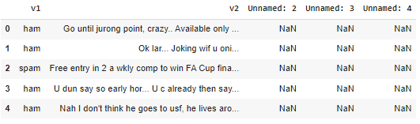
1.Collect the dataset:
https://www.kaggle.com/datasets/uciml/sms-spam-collection-dataset
(Data from Kaggle)
2.Preparing the collected dataset:
Load the dataset using pandas functions,read.csv().
#Reading the data
df=pd.read.csv('/content/spam.csv’)
df.head()
This phase involves
handling categorical
values,imbalance data,
cleaning the text data.

Slide 5
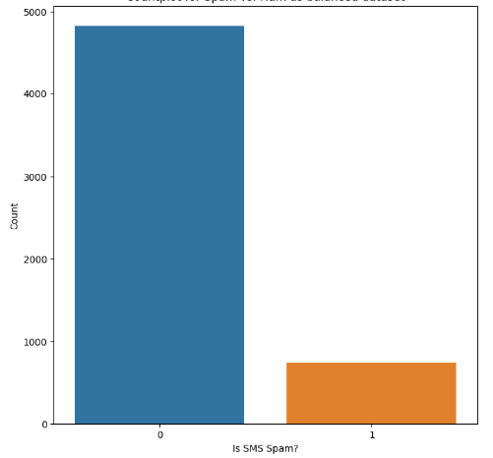
3.Exploratory Data Analysis:
Analyzing Datasets
Summarizes their main
characteristics
Using statistical and
other data visualization
methods

Slide 6
4.Model Building:
Creating a mathematical representation by generalizing and learning from training data.
Build ML model is applied to new data to make predictions and obtain results.
Note: In SMS Spam filtering we use the below algorithms
Naïve Bayes
Decision Tree
Random Forest
Machine Learning
Supervised Learning
Unsupervised Learning
Reinforcement
classification
Regression
Naïve Bayes
Decision Tree
Random forest

Slide 7
5.Performance Testing:
It is a software testing process used for testing the speed,responsetime,stability,reliability, scalability.
Main Purpose:
To identify and eliminate the performed
bottlenecks in the Software application.
6.Tuning:
It is the problem of choosing a set of optimal hyperparameters for a learning algorithms.
Control the overall behaviour of machine learning model.

Slide 8
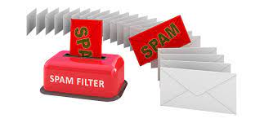
7.Save the model:
The final step is save the
model as a pickle string.
8.Integrate With Web framework
Building HTML pages.
Building server side script.
Run the web application

Slide 9
Conclusion
In these slides I gave broad overview of Machine Learning and different problems that could be solved in this framework.
I reviewed in details one way of SMS Spam Filter implementation using ML Techniques.

Slide 10
THANK YOU!

